Slide 1
Category review: Chips
January 2021
Retail Analytics
Akash Kumar Jha
8093akash@gmail.com

Slide 2
Notes:
To view Privacy video explaining how important data privacy is to Quantium, please click here: https://www.youtube.com/watch?v=Zq1QDAkoRzU
or here Q:\Company Reference\Brand & Design\Brand videos\Q Privacy.mp4
At Quantium, we believe that data is the behavioural footprint of humanity and that it has to be treated with the utmost care and responsibility.
Histories, attitudes, indeed lives are stored within it in ways that aren’t always apparent – and that’s what makes its potential so powerful.
To work with it responsibly, sensitively, we set ourselves the highest data privacy protection and governance standards.
We have spent 17 years perfecting privacy-by-design and secure-by-design principles. Central to this is not holding any personally identifiable information about people –
we neither receive it, and put the necessary protections in place to be unable to decipher it.
Every aspect of handling data is safeguarded: from its de-identification, to its encryption – data security is paramount and of the highest grade.
We pride ourselves on gaining the trust of iconic organisations around the world through years of securely working with their data,
and in turn the trust that builds with their stakeholders.

Slide 3
Executive summary
01
Chips Category Review
The Mainstream category of Young and Mid-age Singles/Couples have the highest spending of chips per purchase.
The Older Families(Budget) have the highest frequency of purchase followed by Young Singles/Couples (Mainstream) and at last Retirees (Mainstream) contributing to a total 25% sales revenue.
Chips Brand Kettle is the most purchased brand in all stores.
Young and Mid-age Singles/Couples is the only segment having Doritos as the highest purchase brand while Smiths is for other segments.
Most frequent chip size purchased is 175 gr followed by 150 gr size for all segments.
Chips transactions increase a lot before Christmas which can be an advantage with the help of promotional offers.
02
Store Analysis
Trial stores 77 and 86 have significant increase in total sales and number of customers during trial as compared to control store.
Trial store 88 had increase as well but not as good as stores 77 and 86.

Slide 4
01
Category

Slide 5
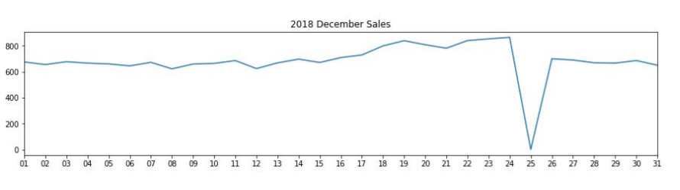
The day with no transaction is a Christmas day that is when the store is closed hence there is a dip in sales on 25th December as shops were non-operational.
Sales increase steadily as the Christmas day approaches and return again to early December sales level during New Year Eve.

Slide 6
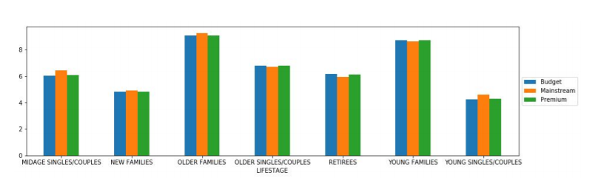
Sales mainly came from Budget - older families, Mainstream - young singles/couples, and Mainstream - retirees. In total contributing 25% of sales revenue.
Older and Young Family segment have the highest average purchase units per unique customer

Slide 7
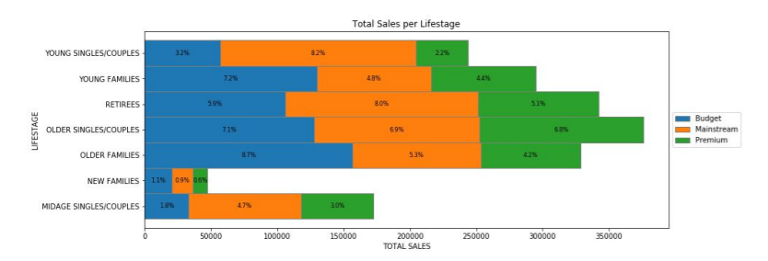
Sales mainly came from Budget - older families, Mainstream - young singles/couples, and Mainstream - retirees. In total, older customers buy more than younger customers. Non-premium customers buy more than premium customers.

Slide 8
02
Trial store performance

Slide 9
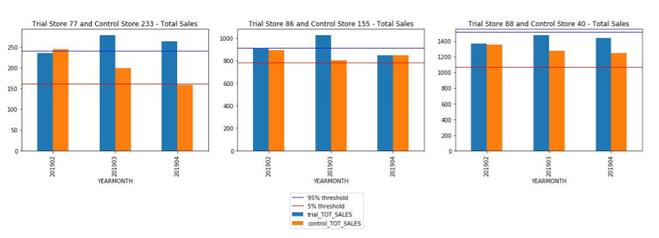
We can see that Trial store 77 sales for Feb, March, and April exceeds 95% threshold of control store. Same goes to store 86 sales for all 3 trial months.
Whereas trial store 88 sales increase is insignificant.

Slide 10
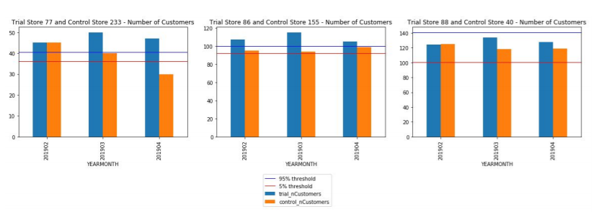
Trial store 77: Control store 233
Trial store 86: Control store 155
Trial store 88: Control store 40
Both trial store 77 and 86 showed significant increase in Total Sales and Number of Customers during trial period. But not for trial store 88. Perhaps the client knows if there's anything about trial 88 that differs it from the other two trial.
Overall the trial showed positive significant result.

